Slide 1
Introduction to CI/CD
Continuous Integration

Slide 2
Agenda
What is CI/CD?
Continuous Integration
Prerequisites
Steps in a CI scenario
The value of CI
Key practices that make up effective CI
Am I doing CI?
References

Slide 3


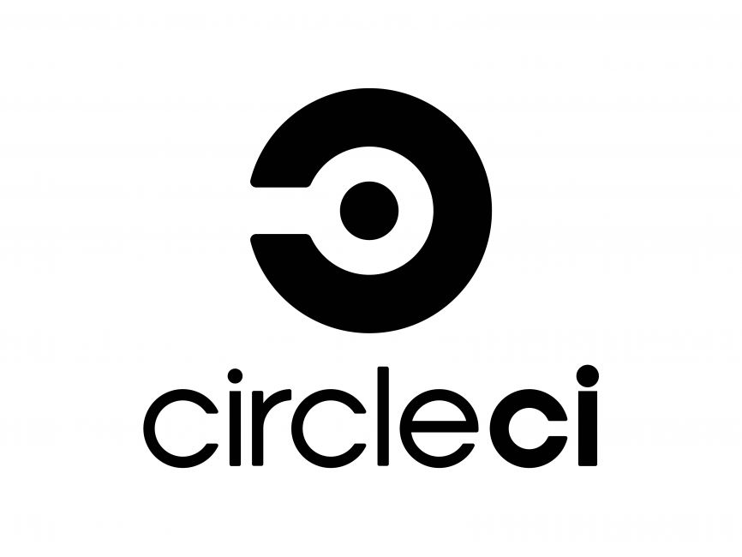

What is CI/CD?
Continuous Integration (CI):
Automate Testing & Builds: Immediately test and build after each commit
Frequent Code Integration: Merge code changes frequently to detect issues early
Fast Feedback: Instantly inform developers of integration issues
Version Control: Essential for managing code changes
Continuous Deployment (CD):
Automate Deployments: Automatically deploy code to production or test environments
Reliable Releases: Ensure software can be released anytime, with minimal risk
Staging Environments: Test in a production-like environment before actual release
Quick Rollbacks: Facilitate easy reverts if a new release fails

Slide 4
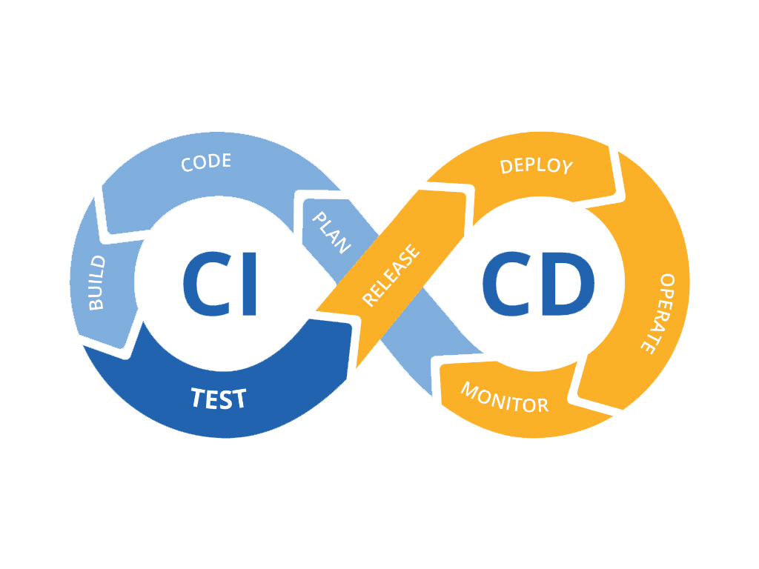
CI/CD
Build Software at every change
Do all the software components work together?
What is my code complexity?
Is the team adhering to the established coding standards?
How much code is covered by automated tests?
Were all the tests successful after the latest change?
Does my application still meet the performance requirements?
Were there any problems with the last deployment?

Slide 5
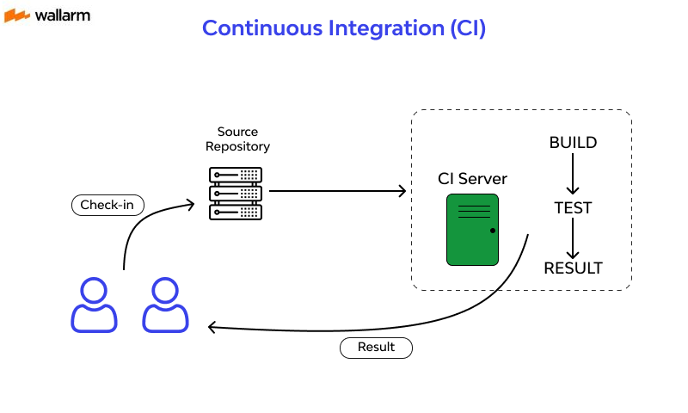
Prerequisites
Version Control System
Git, CVS, SVN
Manage changes to source code and other software assets
Essential for team members collaboration
Go back in time and get different versions of source code
CI Server
Jenkins, Circle CI, Travis CI
Runs an integration build whenever a change is made
Runs the integrations with the mainline branch
Based on a build script
Same steps are executed each time a build is triggered

Slide 6




Prerequisites
Build script
Jenkinsfile, Shell scripting, yaml
A script used to compile, test, inspect, and deploy software
Feedback mechanism
Early feedback on an integration build
Notification system
Sent to all team members.
Integration build machine
A separate machine
Hosts the CI server
Help avoiding false errors introduced building on different systems

Slide 7
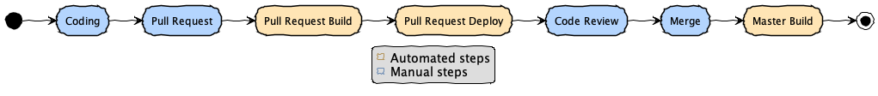
Steps in a CI scenario
How does it work?
A team member opens a PR
The CI Server integrates the changes and builds a snapshot of the software
The snapshot is deployed in an isolated environment
The PR code is reviewed
The PR is merged to mainline – let's say main branch
The CI Server integrates the changes and builds the software

Slide 8
The value of CI
Value of CI
Reduced toil work
Increased confidence for new code
Reduced risk to introduce defects
Software deployable at any time
Project visibility

Slide 9
The value of CI
Reduced risk to introduce defects in the code
Frequent integration
Defects are detected and fixed sooner → compile, tests and code inspection at each commit
Tracking software complexity → tests and inspection in the automated integration process
Assumptions are reduced to minimum → clean environment (e.g., presence of environment variables, connectivity to infrastructure, 3rd-party libraries availability)
Generate deployable software at any point in time
Release deployable software at any point in time.
Most obvious benefit of CI → when a problem occurs, the project members can apply a fix immediately.

Slide 10
The value of CI
Reduces toil* work
Reducing repetitive manual processes saves time, costs and effort.
The process runs the same every time → eliminate the human errors
The process will run as soon as a new commit occurs -> eliminate the human effort
The process steps order is the same → the process steps are the same every time with the same order
Enables project visibility
Notice trends and make effective decisions.
Effective decisions – Recent build status and quality metrics.
Noticing trends – trends in build success/failure, code coverage, build time, etc.
Toil* is a term coined by Google to describe tedious, repetitive tasks associated with running a production environment

Slide 11
The value of CI
Establishes greater confidence in adding new code/refactoring
Tests are run against the software to verify project coding and design standards are met
Confirms the result is a functionally testable product
Team members are more confident in making changes – e.g., during a code refactoring

Slide 12
The value of CI - DORA
Google Cloud’s DevOps Research and Assessment (DORA) team
State of DevOps survey - 36,000 professionals
Level of software delivery performance → overall performance, team performance, and employee well-being
Aspect of Software Delivery Performance | Elite | High | Medium | Low
Change lead time | < 1 day | < 1 week | < 1 month | < 1 month
Deployment frequency | On-demand | < 1/week | < 1/month | < 1/month
Change failure rate | 5% | 10% | 15% | 64%
Failed deployment recovery time | < 1 hour | < 1 day | < 1 week | < 6 months
Percentage of Respondents | 18% | 31% | 33% | 17%

Slide 13

The value of CI - DORA
Five key insights from 2023 Report:
Establish a healthy culture
Build with users in mind
Amplify technical capabilities with quality documentation
Distribute work fairly
Increase infrastructure flexibility with cloud
Measured effects:
Developer burnout
Job satisfaction
Productivity
Organizational / team performance

Slide 14
Key practices that make up effective CI
🔧 Maintain a single source repository
😎 Commit code frequently
🔧 Automate the build
🔧 Make the build self-testing
😎 Fix broken builds immediately
🔧 Every commit should build on an integration machine
😎 Keep the build fast
😎 Everyone can see what’s happening
🔧 All tests must pass

Slide 15
Key practices that make up effective CI
Maintain a single source repository
Everything should be in the repository
Have a mainline: a single branch of the project currently under development
Commit code frequently
Integrate changes early and often
Make small changes
Commit after each task
Automate the build
If it can be automated – it should be automated
Include everything in the automated build
Make the script configurable to build only some targets
Improve build time by using caches

Slide 16
Key practices that make up effective CI
Make your build self-testing
Include automated tests in the build
Fail the build if the tests fail
Fix broken builds immediately
Unlock other team members to test their integrations
A failed build may hide failed tests, bugs or 3rd party integrations errors
Waiting too much to tests the integration will make team members to get frustrated with the CI
Every commit should build the mainline on an integration machine
Environment differences may result in false positives
Builds should be tested on the same environment/infrastructure each time

Slide 17
Key practices that make up effective CI
Keep the build fast
Waiting too long for the build may end up in frustration and taking shortcuts in the future
Caches for 3rd party libraries is a good practice
If the CI/CD takes too long, most teams will not adopt it
All tests must pass
100% of a projects' automated tests must pass for the build to pass
Coverage code should not be reduced. Adding code that is not tested may contain (more) bugs
Everyone can see what's happening
Everyone has access to see the system state at any time
Using a display on the build system that shows different colors for build state success and failed is a good practice. Not only it displays the build state, but it also states for how long it has been in that state

Slide 18
Automate deployment
For a successful CI, there is a need to run multiple environments:
An environment to run commits integration with the mainline
Mainline should be ran at least on one integration environment before going to production
Since this environments will be spin up multiple times a day, an automated way has some advantages:
will make things easier and the team will get more confident to write and deploy code
will speed up the process
will reduce the errors that may be introduced by running the deployment manually

Slide 19
Am I doing CI?
How do we know we are doing CI? Here are some questions to answer:
Are we using a version control repository?
Is the project build process automated and repeatable? Is it triggered and completed without intervention?
Are we running automated tests and adding them for new code?
Are we running the tests as part of the build? Does the build fail if the tests fail?
Are we enforcing coding and design standards?
Do we have at least one feedback mechanism in place?
Do we build the software on a separate integration machine?

Slide 20
References
Continuous Integration: Improving Software Quality and Reducing Risk, by Paul M. Duvall, Steve Matyas, Andrew Glover
Continuous Integration vs. Continuous Delivery vs. Continuous Deployment, 2nd Edition, by Brent Laster
Continuous Integration, Martin Fowler - https://martinfowler.com/articles/continuousIntegration.html
2023 State of DevOps Report: Culture is everything - https://cloud.google.com/blog/products/devops-sre/announcing-the-2023-state-of-devops-report

